Slide 1
IAM Approach to Line Pressure Surveillance
August 22nd, 2018

Slide 2
Agenda
Background / History
Workflow Steps
Workflow Outputs
Physics Based Modeling
  IPR/VLP & Mach Number
JMZ 1C-3HZ Model
  Early Life & Today
Economic Benefits
Path Forward

Slide 3

Background / History
Lower line pressure has always been desired by production
  High Impact during summer due to compressors
  Pressure equals money:
    Pressure Increase = Production Decrease & Deferred Revenue
    Pressure Decrease = Expenditure & Capital Spend
    Need to find the equilibrium point between the two
Historically no good way of quantifying the problem
  Too many wells & variables
Insufficient clear data for gathering commitments
  Contracts need to be clearly defined (i.e: What pressure at with what volume?)
During summer months potential value estimated for APC:
  +/-2,000 bpd and +/-$11MM @ $60/bbl

Slide 4
Elevating the IOC & Field Operations
Real time oil / gas opportunity loss analysis by well
Enhanced daily & weekly IOC reporting
Identifying high pressure ‘quadrants’ of the field
Turn compression on earlier & enhanced KMOG/WES alignment
High backpressure inside the production facility
Piping and control valve modifications to reduce wellhead back-pressure
Identifying wells that are flowing in subsonic flow that are more susceptible to line pressure increases
Tune wellhead telemetry to increase production
Workflow programmed to pull historical line pressure averages by production battery
Data support in KMOG/WES contract discussions

Slide 5
Workflow 1 Steps
Pull Tubing Pressure, XMV Pressure & Sales Line Pressure
Filter Bad Data From Pressures
Pull Downtime Codes From PDB
Break Pressures up into 6 hour increments
Delete Pressures associated with planned avoidable
Associate downtime codes with pressure timestamps
Flag trends w/ positive slope & w/ >15% increase
Bin pressures into 50 psi increments
Calculate Delta between XMV & Sales Line pressures

Slide 6
Workflow 2 Steps
Pull production yesterday and production targets
Get production deltas for days w/ exceptions
Pull exception flags for all wells
Sum deficits for wells and field by day and week
Multiply deltas by commodity prices

Slide 7
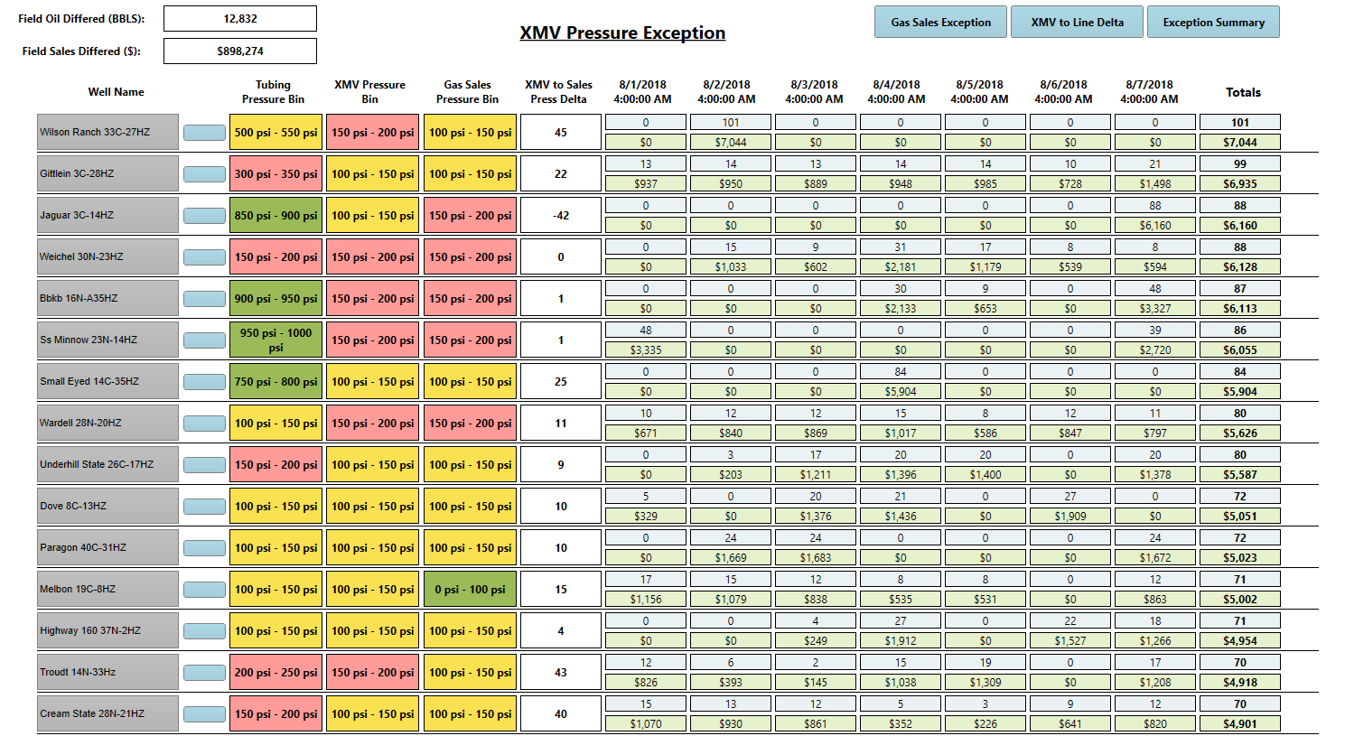
XMV Pressure Exception
Pressure Bins
Pressure Deltas
Daily Deferred Volumes & Sales
Weekly Deferred Volumes & Sales

Slide 8
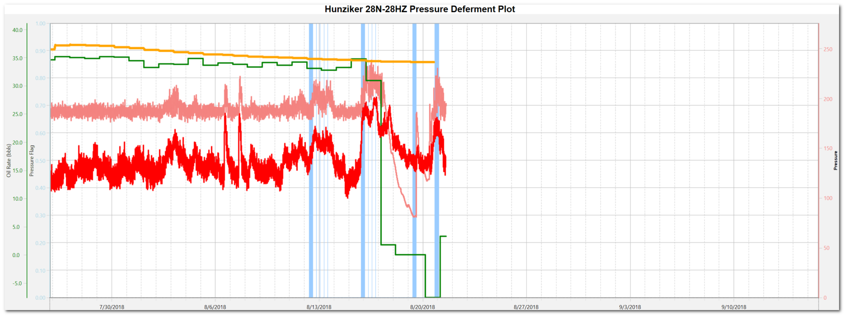
Flagged Pressure Exception
Oil Goal
Oil Yesterday
XMV Pressure
Gas Sales Pressure
Flagged Pressure
Flagged pressure increase and production Delta

Slide 9
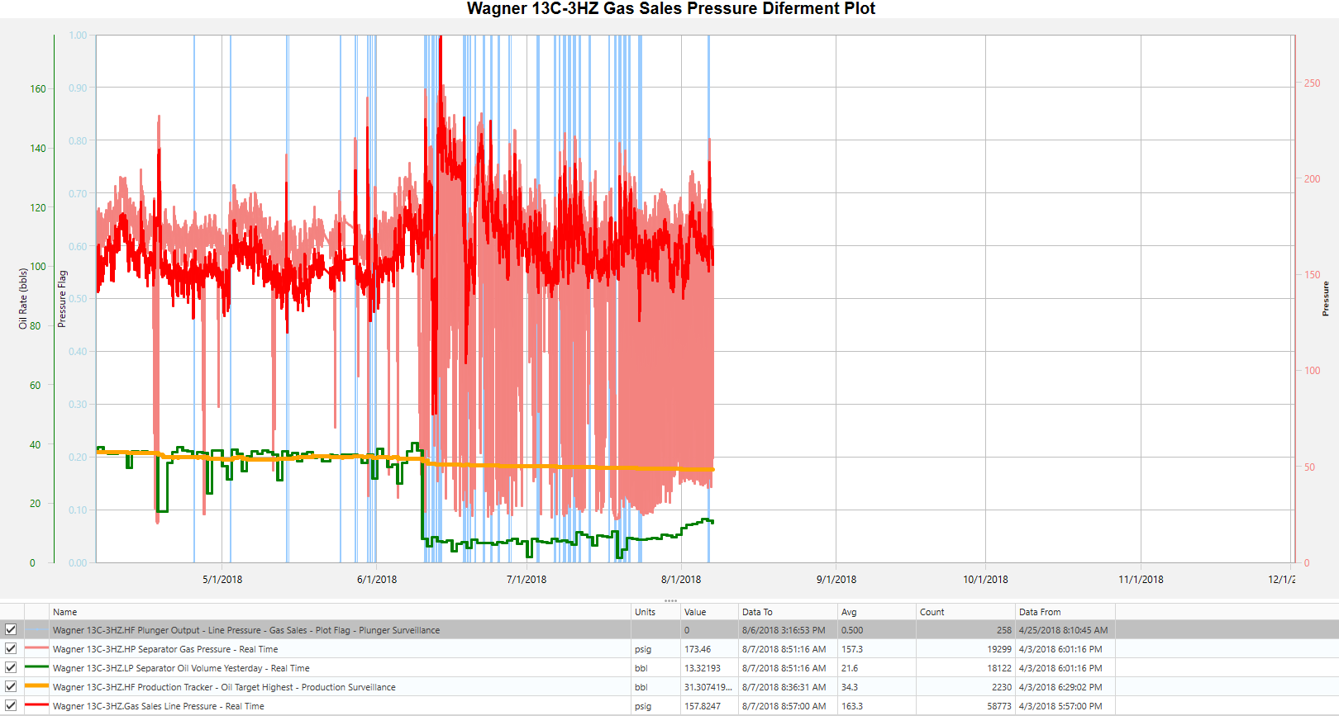
Flagged Pressure Exception
Oil Goal
Oil Yesterday
XMV Pressure
Gas Sales Pressure
Flagged Pressure

Slide 10
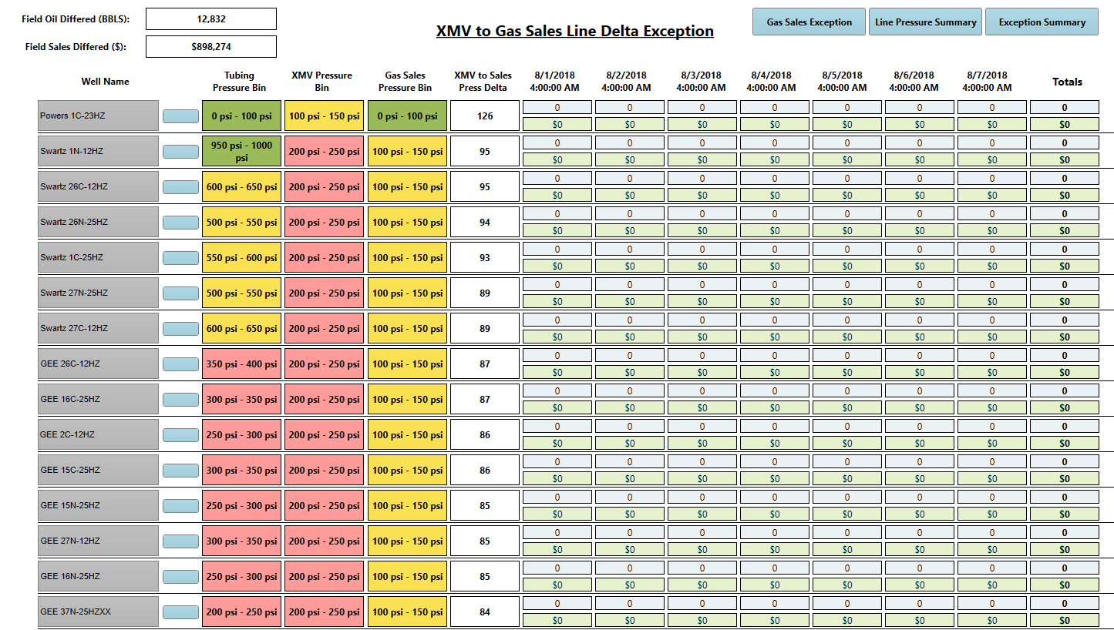
XMV to Gas Sales Line Delta
Sorted by pressure delta

Slide 11
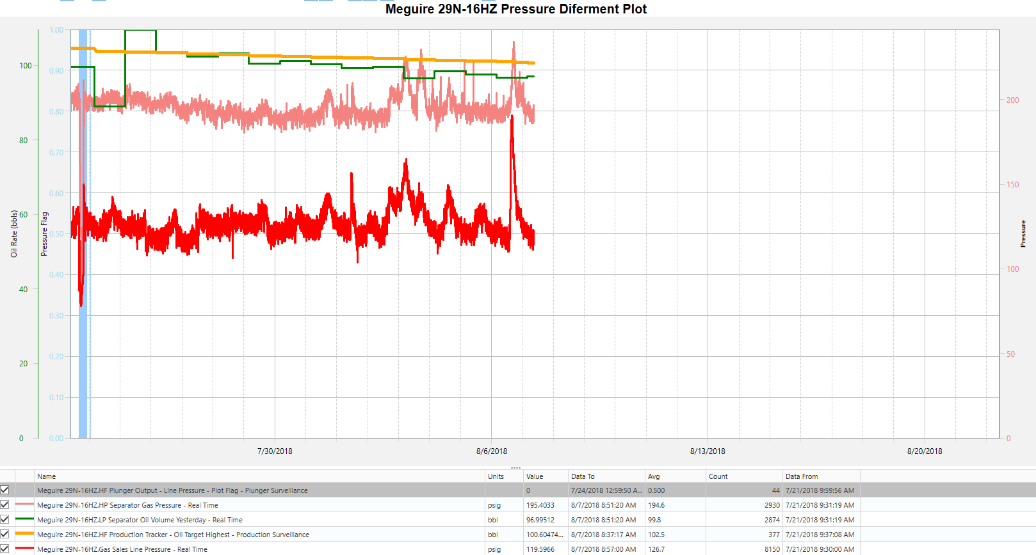
XMV to Gas Sales Line Delta
+/-60 psi Delta
Potential to lower pressure upstream of gas sales

Slide 12
Inflow Performance Relationship
Relationship Between:
  Reservoir Pressure
  Flowing Bottom Hole Pressure
  Production Rate
Stable in conventional plays
  Sand Stone, etc.
Dynamic in unconventional plays
  Shale, etc.
IPR can change rapidly in shale plays
Reservoir Pressure (psig)
Production Rate (bpd)

Slide 13
Vertical Lift Performance Relationship
VLP: Relationship between bottom hole & surface
  How production flows from bottom hole to surface
Dependent on:
  Well Depth
  Tubing Size
  Water Cut
  GOR
  PVT Properties
  Surface Pressure
Increase surface Pressure shift up
Decrease surface pressure shifts down
Reservoir Pressure (psig)
Production Rate (bpd)

Slide 14
Combining IPR & VLP
Intersection is operating point.
Changes in surface pressure change production rates with all other variables held constant
Reservoir Pressure (psig)
q_{p}
q_{p}
q_{p}
Production Rate (bpd)

Slide 15
Compressible Flow
Gas at subsonic flow acts like an incompressible fluid
  If line pressure goes up, well head pressure goes up
Gas at supersonic flow acts like a compressible fluid
  If line pressure goes up, well head pressure isn’t effected

Slide 16
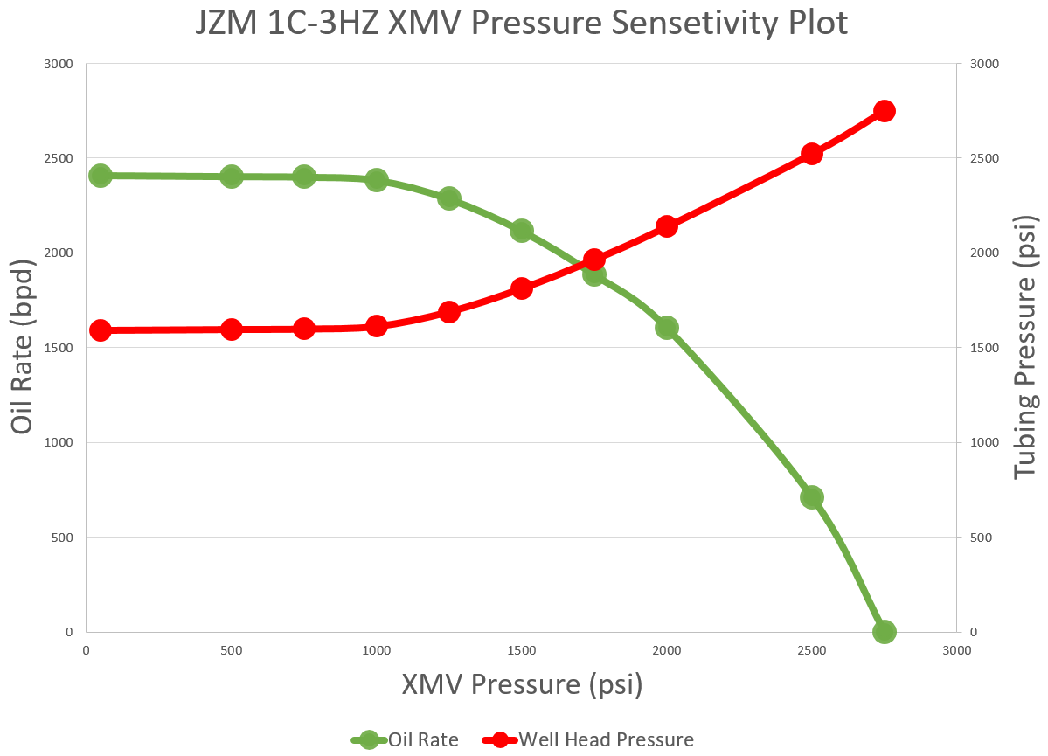
XMV Pressure Sensitivity Example 1
Doesn’t load until XMV pressure of +/-2,750 psi
Early life doesn’t show signs of production decrease until XMV pressure of +/-1,250 psi

Slide 17
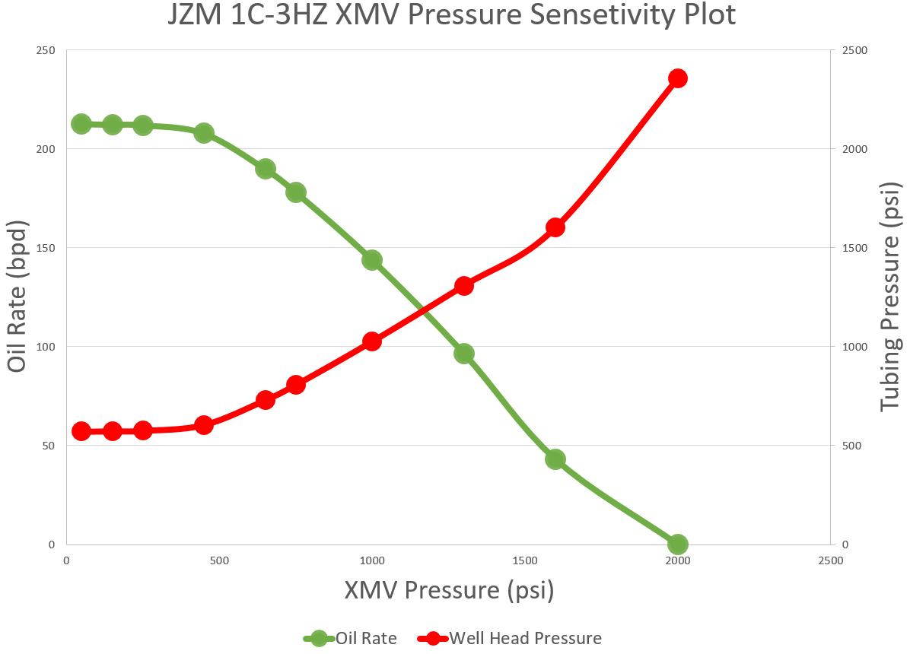
XMV Pressure Sensitivity Plot Example 2
Current day production decrease at +/-650 psi
Doesn’t load up until XMV pressure of +/-2,000 psi

Slide 18
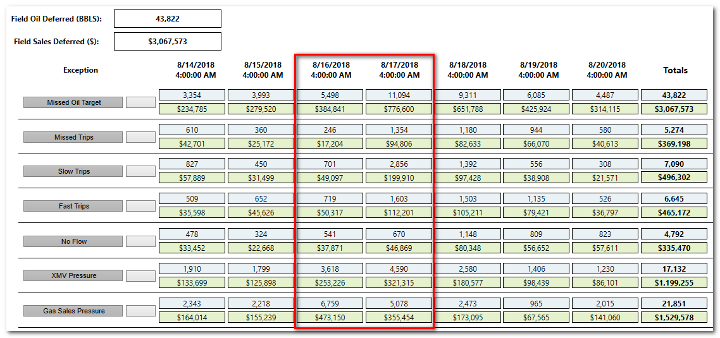
Economics – Line Pressure Impact

Slide 19
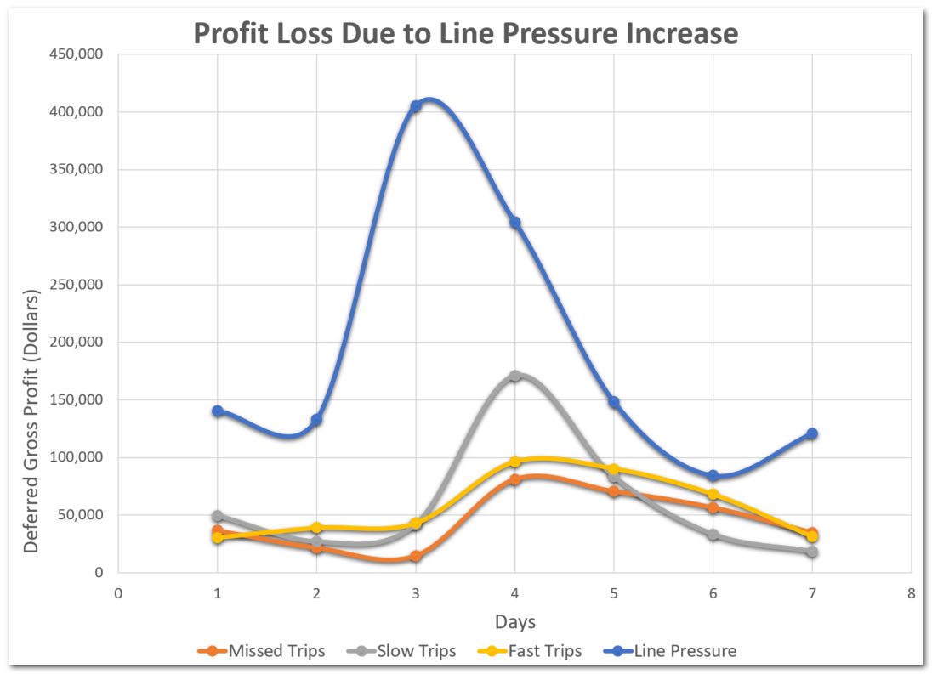
Economics – Line Pressure Impact
Total of +/-$1.3MM deferred for week when average is +/-$800k for line pressure
Line pressure increase cause of plunger exceptions

Slide 20
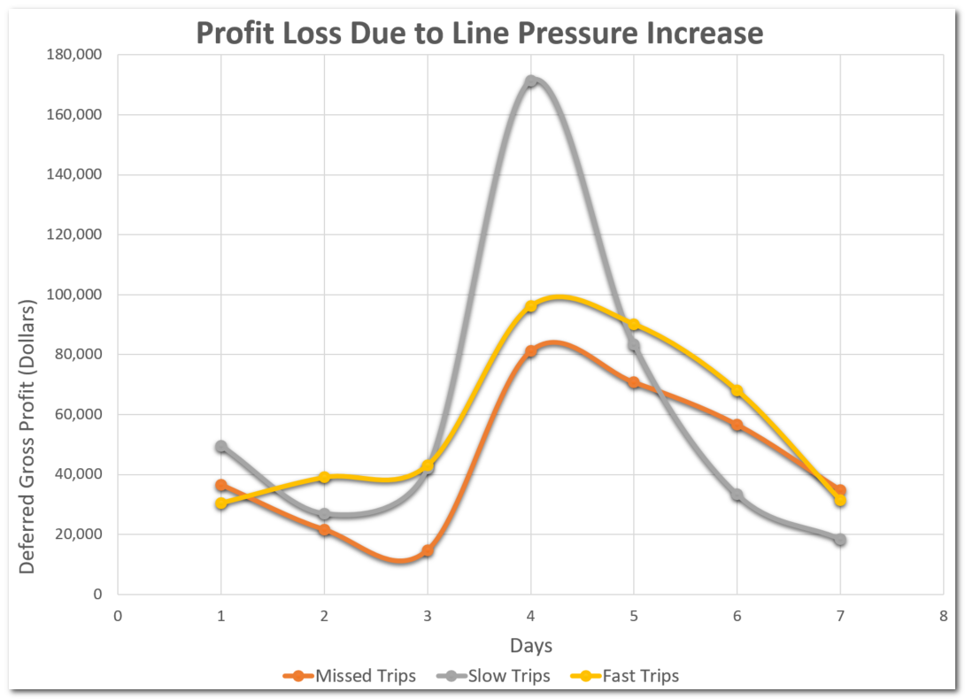
Economics – Line Pressure Impact
Total of +/-$1.1MM Deferred for week when average is +/-$750k
Remains high even after line pressure goes down

Slide 21
Elevating the IOC & Field Operations
Real time oil / gas opportunity loss analysis by well
Enhanced daily & weekly IOC reporting
Identifying high pressure ‘quadrants’ of the field
Turn compression on earlier & enhanced KMOG/WES alignment
High backpressure inside the production facility
Piping and control valve modifications to reduce wellhead back-pressure
Identifying wells that are flowing in subsonic flow that are more susceptible to line pressure increases
Tune wellhead telemetry to increase production
Workflow programmed to pull historical line pressure averages by production battery
Data support in KMOG/WES contract discussions

Slide 22
Path Forward
Run macro rollup summaries
  Resultant effects from line pressure
  Jan 1st 2018 to present
Understand & capture contract violations automatically
  Exceed contract thresholds
Generate weekly reports for management
  More data for meetings with third parties
Multi-disciplinary team workshop
  Attack the things APC controls
Incorporate physics based models
  What if scenarios for line pressure

Slide 23

Questions

